Slide 1
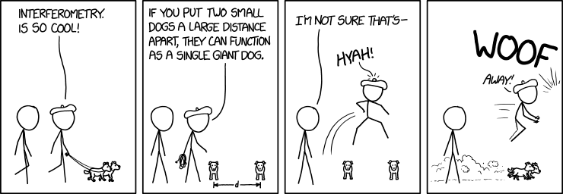
Towards distributed Image Reconstruction for Radio Interferometers

Slide 2
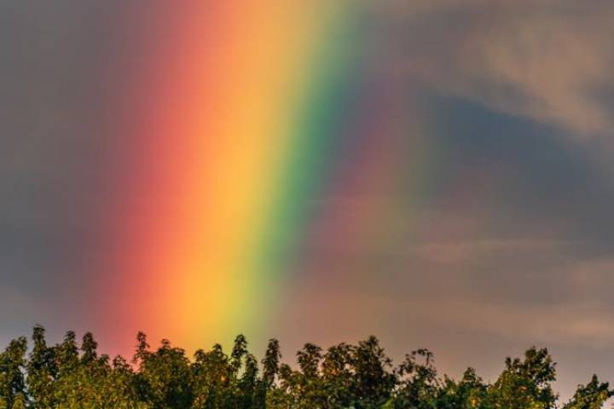
Our eyes see only a fraction of EM wavelengths…

Slide 3
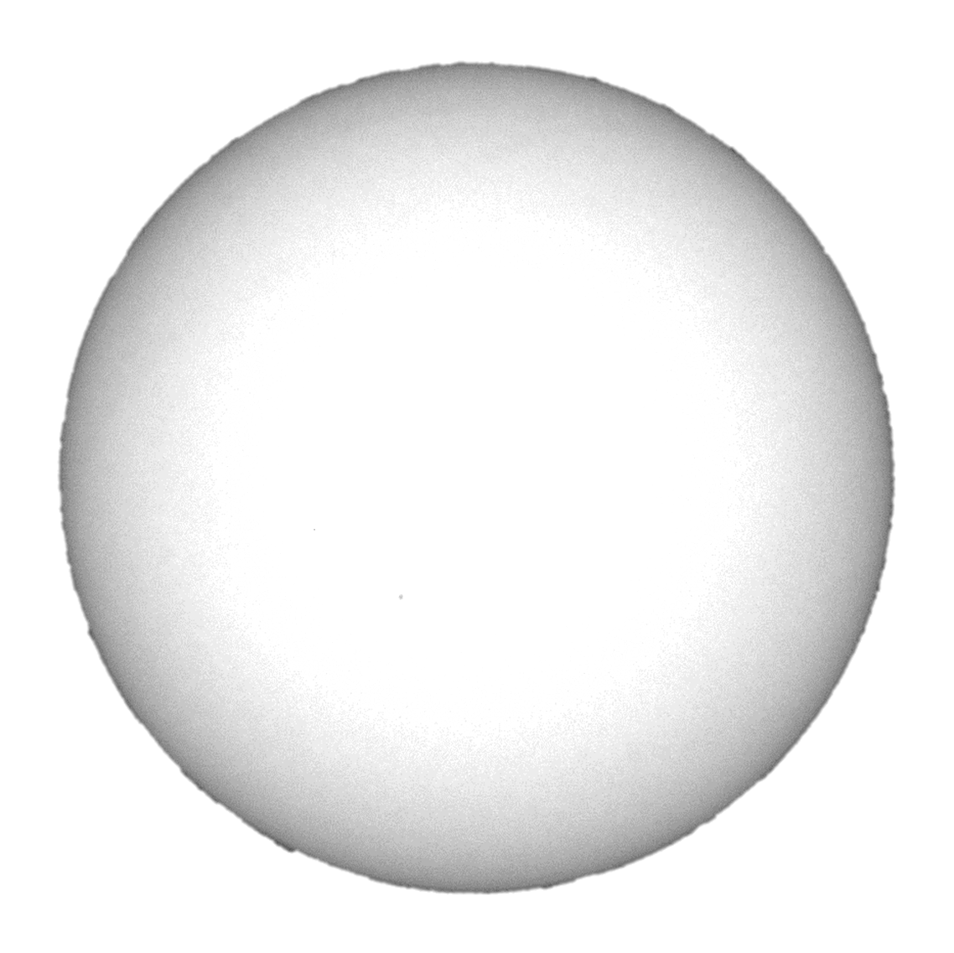
Our Sun at wavelengths visible to our eyes

Slide 4
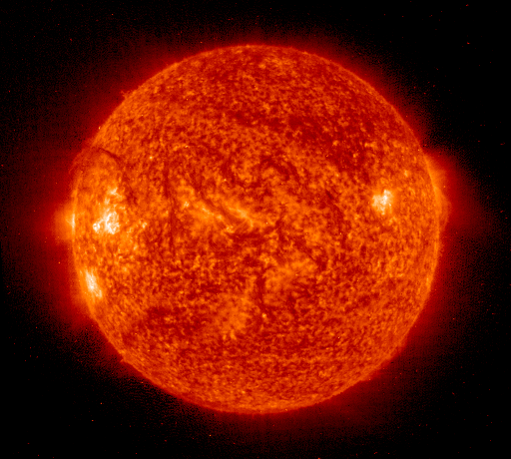
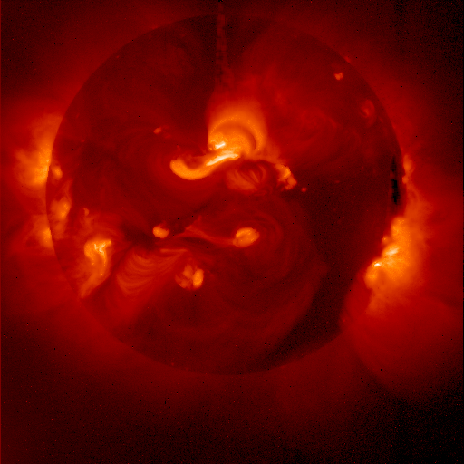
Our Sun at smaller wavelengths

Slide 5
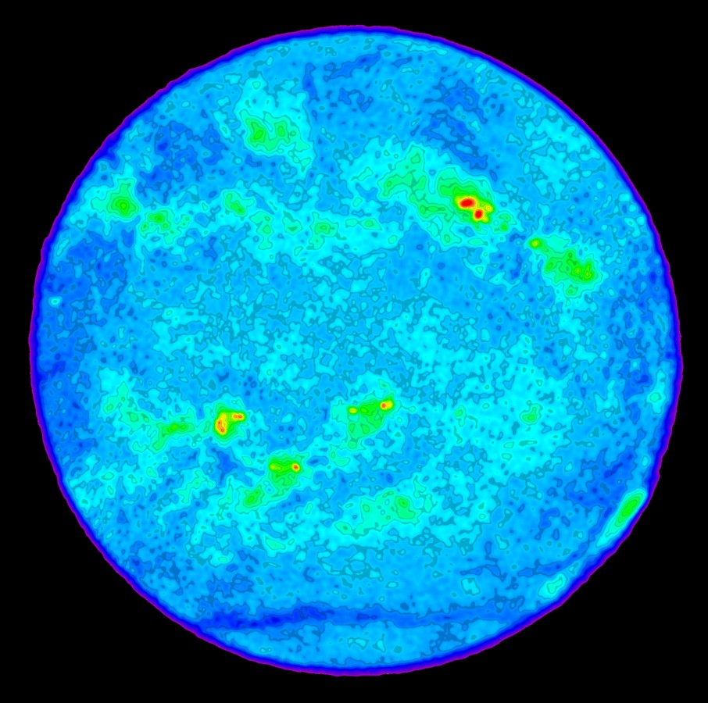
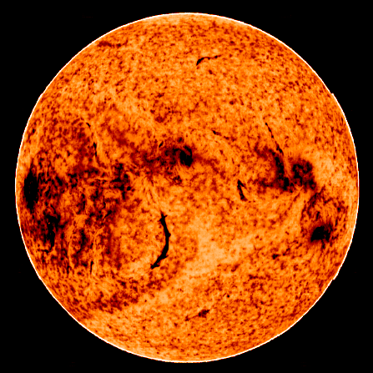
Our Sun at longer wavelengths

Slide 6
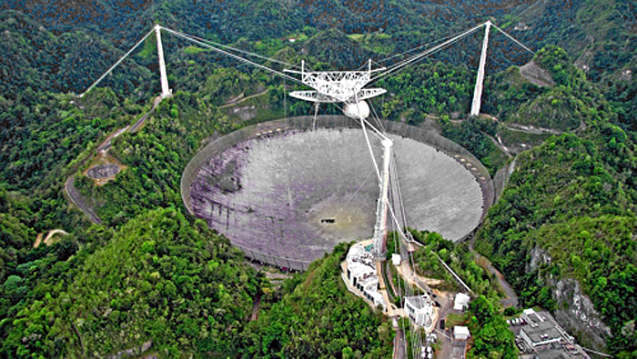
Longer wavelengths require larger dishes to focus

Slide 7
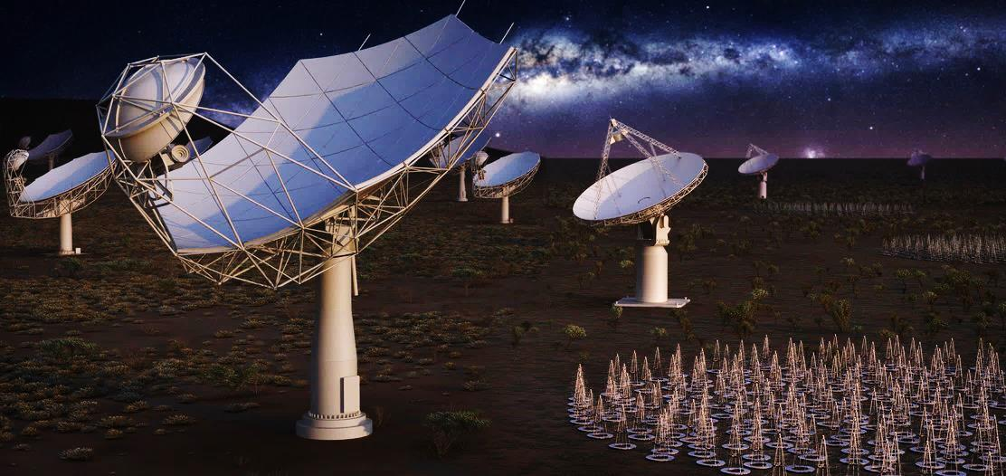
Square Kilometer Array (SKA)

Slide 8
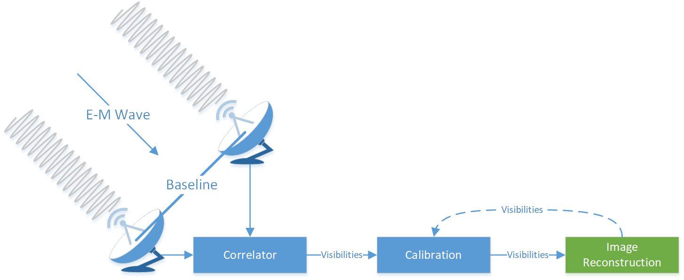
Radio Interferometry System

Slide 9
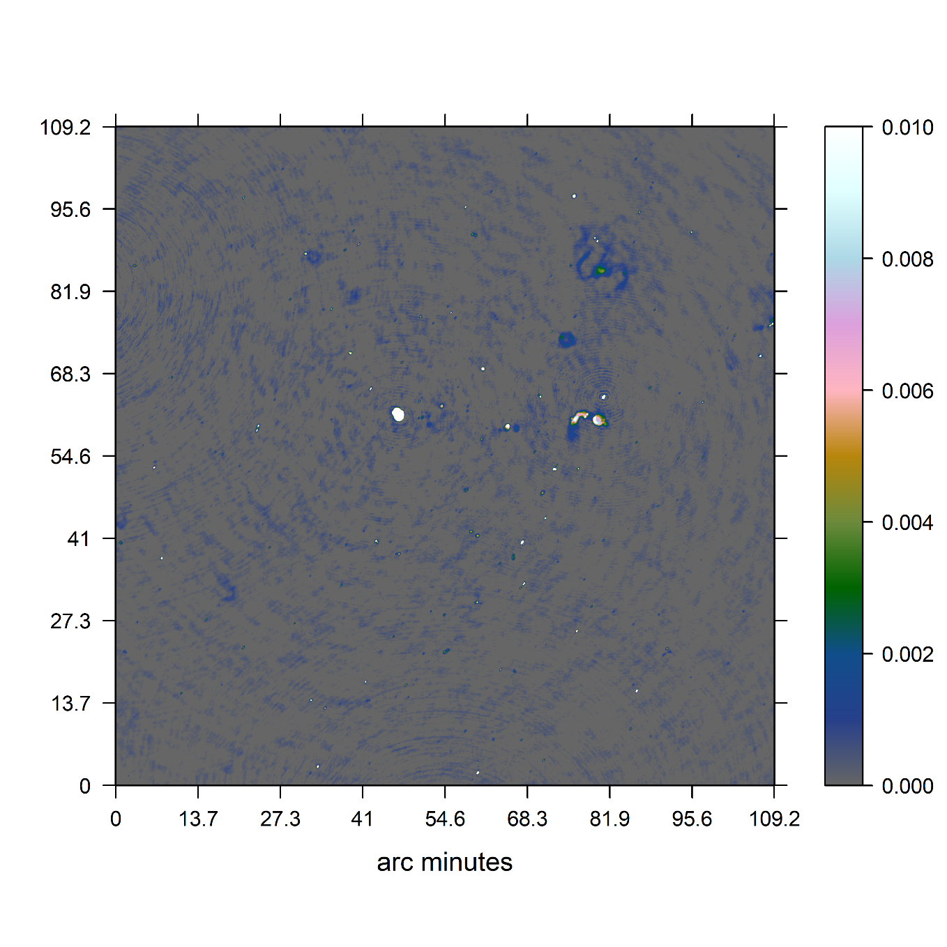
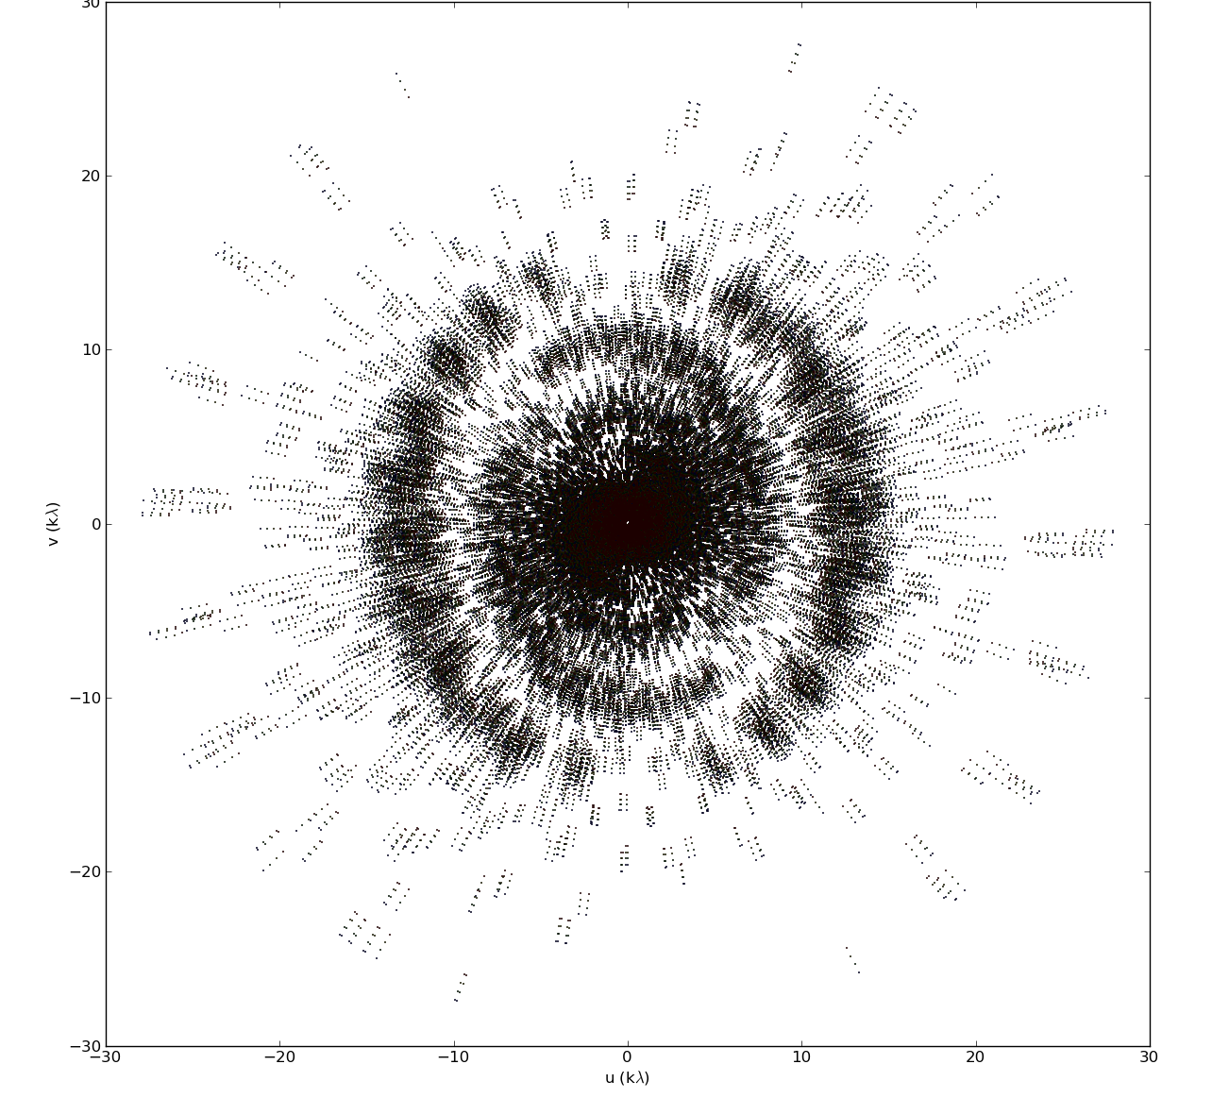
Image Reconstruction

Slide 11
Major / Minor Cycle

Slide 12
Major / Minor Cycle
~ 4 GB
32k * 32k image
< 1%
Non-Zero Pixels
Terabytes <<

Slide 13
Distribute Gridding!

Slide 14
Distribute Gridding!
(Gridding benefits from many nodes)
May let us keep the calibrated visibilities in-memory
New gridders like IDG use GPU acceleration
But what about deconvolution?
Deconvolution may become the most time consuming step
(Deconvolution is done only on one node)
All other nodes idle during deconvolution
We can use the idling nodes for deconvolution

Slide 15
The problem of distributed deconvolution
(Image PSF)

Slide 16
Distribution can exploit the data properties
How large is the PSF
How large is the grid vs. the calibrated Visibilities
How sparse is the model image
…
Test on a real world MeerKAT observation

Slide 17
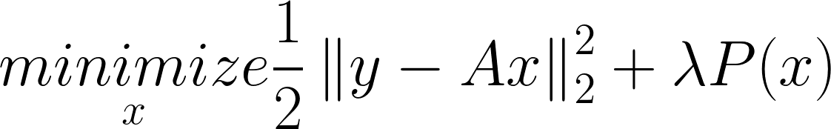
Compressed Sensing based deconvolution
Deconvolution as a system of linear equations
A represents convolution
P() represents the prior knowledge about our image
Optimization algorithm needed, Gradient Descent, ADMM…
CLEAN can be seen as a Compressed Sensing based deconvolution

Slide 18
Compressed Sensing
Prior P() → ElasticNet
Optimization Algorithm → Coordinate Descent

Slide 19
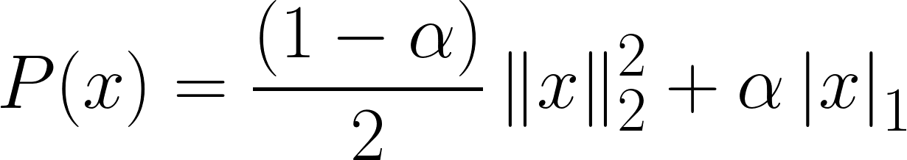


ElasticNet Prior
Mixture between L1 and L2 Norm

Slide 20
Coordinate Descent
Minimizes one Pixel at a time
Effective for high-dimensional problems
More sophisticated variants

Slide 21
Simple Distributed Deconvolution
(4 image patches)

Slide 22
Simple Distributed Deconvolution

Slide 23
Preliminary Results
Implemented in C# .netcore
1 Node vs 4 Nodes
Speedup of a factor 3.2

Slide 24
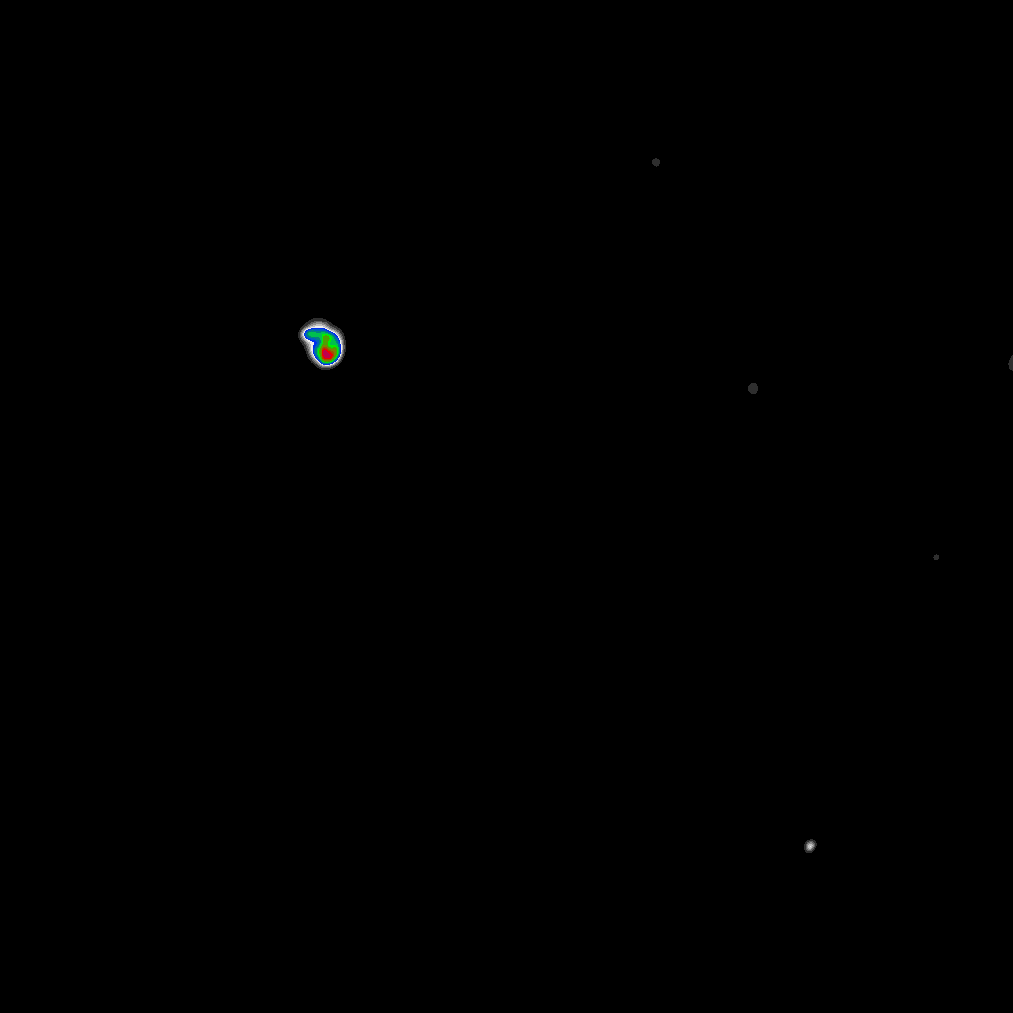

Preliminary Results

Slide 25
Limitations
Latency Limited
Proof of concept implementation (speedup factor is inaccurate)
Data volume not (yet) representative

Slide 26
Opportunities
CD deconvolution with GPU acceleration
More sophisticated CD algorithms, but viability depends on the PSF

Slide 27
Next Steps
GPU Acceleration for Coordinate Descent
Test on Azure Cloud
MORE DATA

